Slide 1
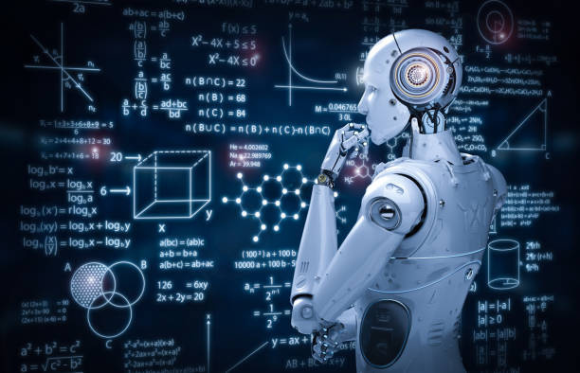
Welcome to Python & Machine Learning Adventure
Today’s objectives:
  Learn how code and data can make machines intelligent (fundamental concepts)
  Setup your device for Ready to code
Organized by Sayapatri Group – Society, IT & Technology

Slide 2
Welcome to an exciting journey into the world of Artificial Intelligence! This course will equip you with the foundational skills in Python, Machine Learning, and Deep Learning to navigate and innovate in the rapidly evolving tech landscape. Get ready to transform your understanding and career prospects.

Slide 3



Why Python, Machine Learning, & Deep Learning?
Real-World Impact
High Industry Demand
Creative & Powerful
From self-driving cars to personalized recommendations, AI is everywhere, solving complex problems and enhancing daily life.
AI engineers, data scientists, and ML specialists are among the most sought-after professionals globally, commanding competitive salaries.
It's not just about code; it's about building intelligent systems that can learn, adapt, and innovate across various domains.

Slide 4
Unlock Diverse Career Paths
  Data Science: Extract insights from data.
  Sector-Specific AI: Finance, Healthcare, E-commerce, and more.
  Global Opportunities: Lucrative salaries and worldwide demand for skilled professionals.
  AI/ML Research: Push the boundaries of intelligent systems.
  Deep Learning: Specialise in Computer Vision, NLP, or Robotics.

Slide 5
Prerequisites: Your Starting Line
1
2
Basic Computer Knowledge
Problem-Solving Interest
Comfort with navigating operating systems and basic software applications.
A curious mind and eagerness to tackle challenges are key drivers for success.
3
4
No Prior Coding Required
Math Foundations
Python is beginner-friendly; we'll start from the absolute basics, making it accessible to all.
Basic understanding of linear algebra, probability, and calculus can be beneficial, but not strictly necessary for the start.

Slide 6





Maximising Your Learning: Course Best Practices
Practice Daily
Hands-on coding reinforces concepts better than passive learning.
Collaborate
Work with peers; diverse perspectives enhance problem-solving.
Ask Questions
Clarify doubts immediately; no question is too basic.
Build Projects
Apply weekly concepts to small projects for practical experience.
Revise & Experiment
Regularly revisit concepts and try new things with your code.

Slide 7




Your Transformation After 45 Hours
Python Proficiency
ML Model Building
Master basics: syntax, data structures, and essential libraries.
Confidently build simple regression and classification models.
Deep Learning Implementation
Project Ready
Implement foundational Artificial Neural Networks (ANNs) and Convolutional Neural Networks (CNNs).
Showcase projects like a spam classifier, image recognizer, or recommendation system.

Slide 8
Let’s get some understanding on machine learning
  Subset of AI
  most trending topics in the world these days

Slide 9
Analogy: Teaching a child
    Imagine teaching a child to identify a dog. You don't give them a list of complex rules about fur color, ear shape, and size. Instead, you show them many pictures of dogs and point, saying "dog".
    Over time, the child starts to recognize patterns and can correctly identify a dog they've never seen before.
    Machine learning is the same process: you give the computer lots of data (pictures of dogs with "dog" labels), and it learns to spot patterns and make correct identifications on its own.

Slide 10
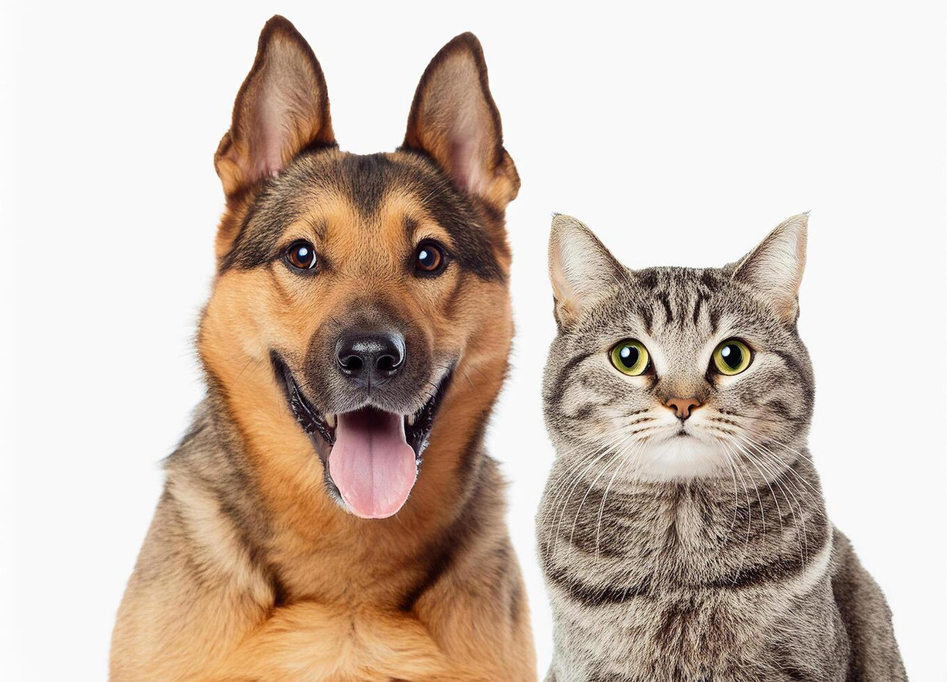
For Example:
Write a program to scan a image between cat and dog

Slide 11
  If we try to do this problem using tradition programming concepts, it will be more complex because we have to make rules on every lines and edges of the image so it is very difficult or sometime almost impossible
  If i give the black and white photo then those rules will not work, they may break.
  Or if i give the picture of dog and cat from different angle then you didnot predict before.
So solving these types of problem using traditional programming will be overly complex.

Slide 12
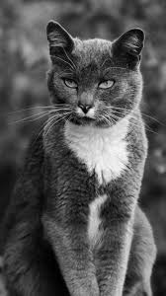
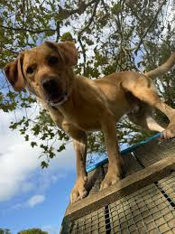

Slide 13
What if in the future i ask to extend this program such that if support to scan three kind of animals - cat, dog and horse
  The it will be more worse and have to rewrite all those rules.
Then what can be the solution to these problems?
🤔

Slide 14
→ Here, we utilize the power of machine learning
It works on the way how we recognize the different objects.
We build a model or engine and give it lots and lots of data. For example, we give thousands or tens of thousand of pictures of cats and dogs, our model will then find and learn patterns in the input data so we can give it a new picture of a cat and ask for is it cat or dog or horse, it will tell us with a certain level of accuracy.

Slide 15
The more input data we give it, the more accurate model is going to be.
It is the basic understanding of machine learning but it has a very wide application from self-driving cars, robotics to language processing, vision processing and so on.

Slide 16

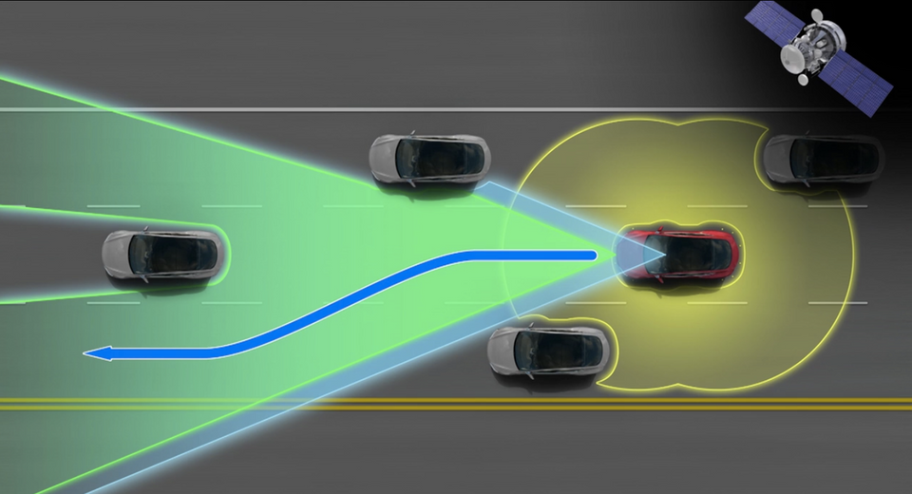
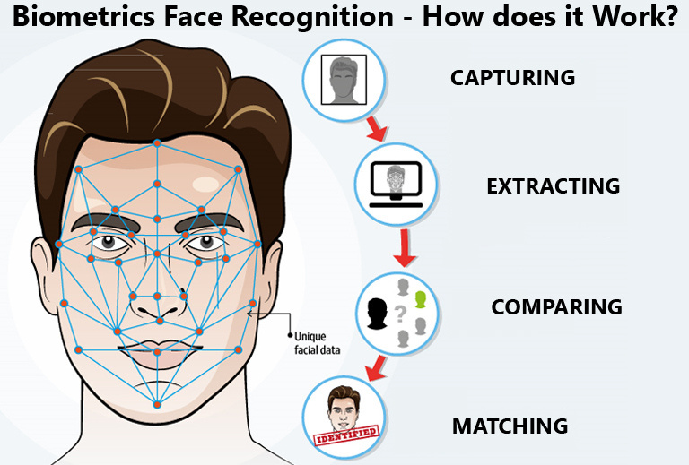


Slide 17
Machine learning in Action
We will learn in detail later...

